Slide 1



STUDENT INFORMATION MANAGEMENT SYSTEM
BY TEAM MAS

Slide 2

WELCOME

Slide 3
Team Information
Sourov Biswas(004)
Syed Mahi Hossen (609)
Jaki Adib Khan(012)

Slide 4
TABLE OF CONTENT
1
Introduction
2
Features
3
Functionality Description
4
Limitations of our program
5
Conclusion

Slide 5


ABOUT THE PROJECT
Student Management System is a simple console application with a Command Line User Interface.
This project contains various types of data structures to store, delete, search, etc functions.
C++ language is used to develop the program

Slide 6

FEATURES
01
Add New Student
05
Delete Single
06
02
Delete all
Search by ID
03
View All
07
Restore
04
Update Information
08
Recycle Bin

Slide 7
REQUIREMENTS
HEADER FILES
C++ Compiler
bits/stdc++.h
windows.h
fstream
Codeblocks, VS Code, CLion, Dev C++ etc.

Slide 8
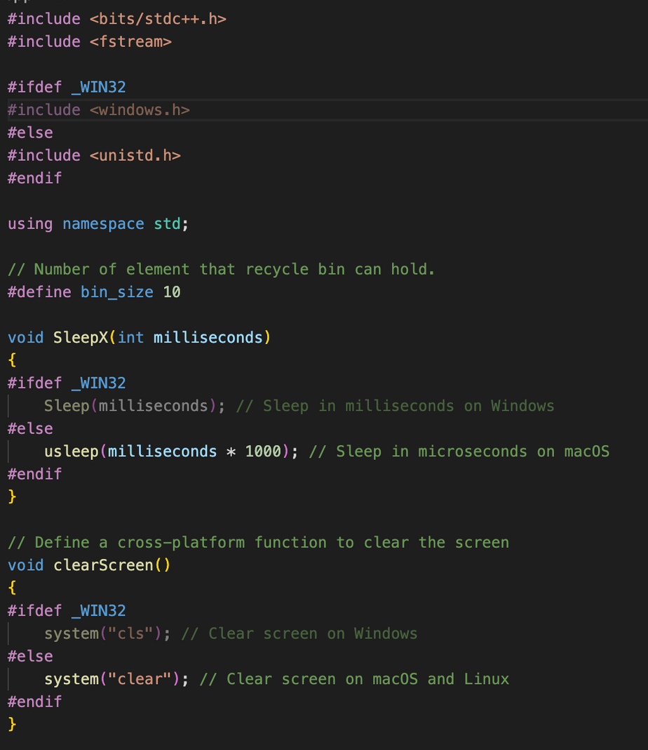
OS COMPATIBILITY

Slide 9
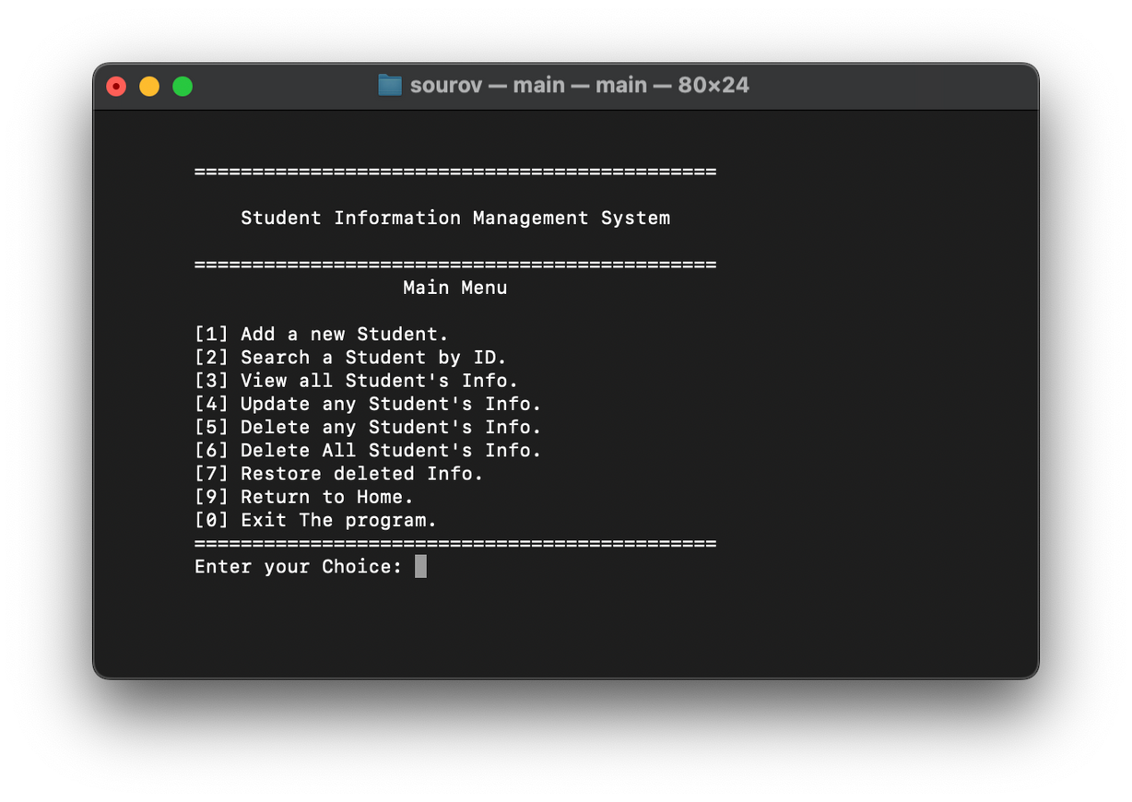
ADD FUNCTON
This function is to add new student’s information to the list.
A students information contains bellow information.
Student ID
Name
Phone Number
E-mail Adress
Number of Courses
All Couse Codes
All Course Name

Slide 10
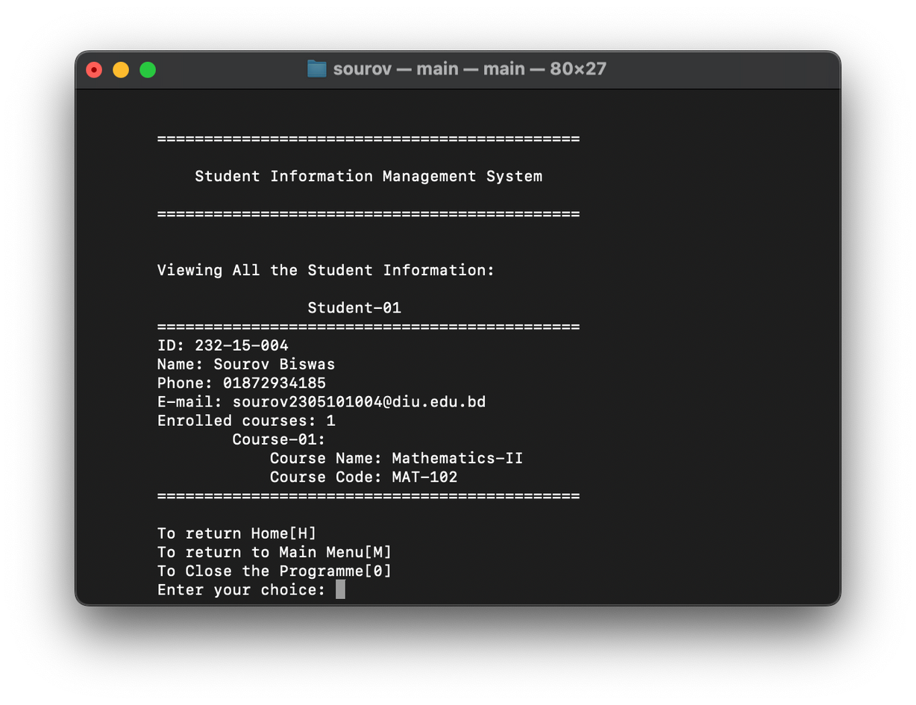
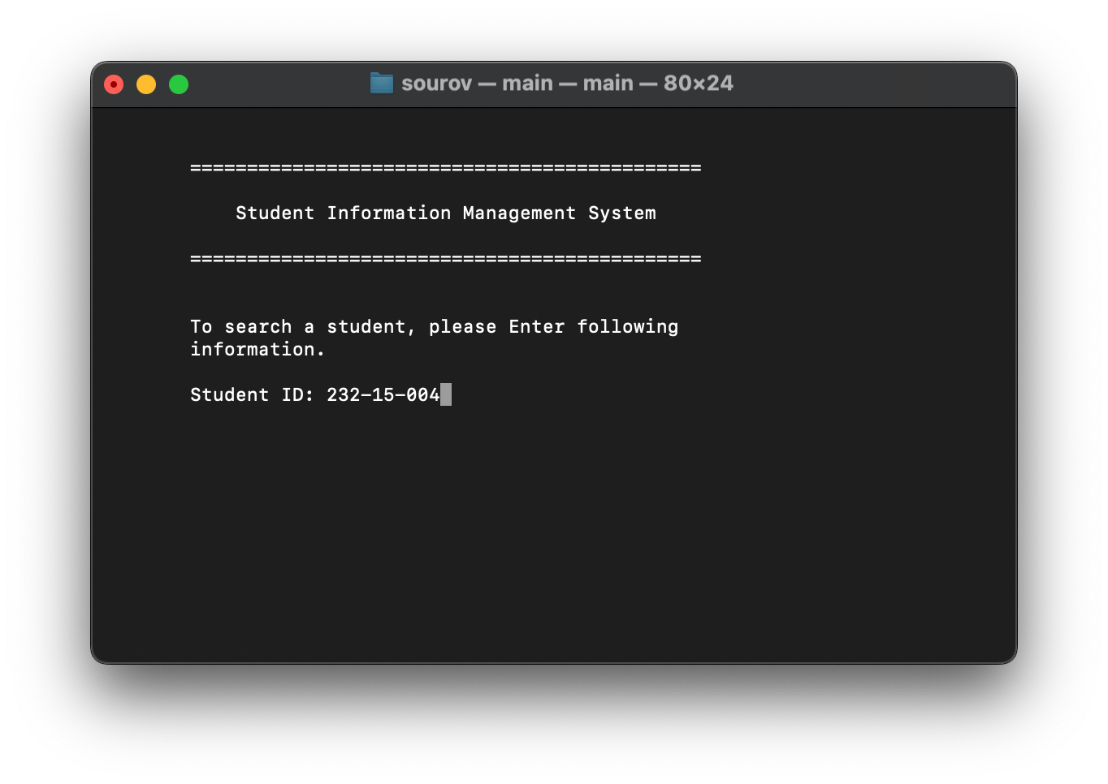

SEARCH BY ID
VIEW STUDENTS INFORMATION
Input a student’s ID to view all his/her information
This option displays all the student’s information that is stored in the system

Slide 11
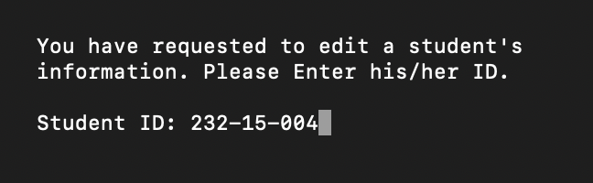
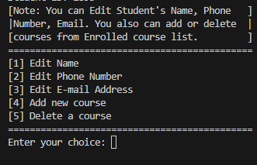
UPDATE INFORMATION
This Function helps to update the student’s information by giving student ID
Users can edit Students Name, Phone, Email, Course info, etc.

Slide 12
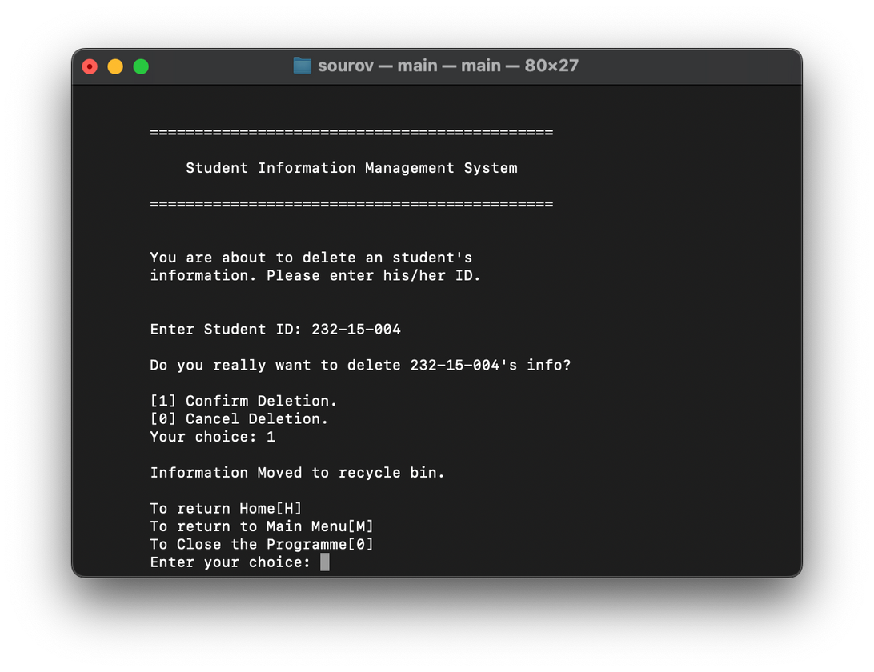

DELETE SINGLE
First of all we need to have a student id in our database
Then, we can delete it manualy from the Delete any Student's Info option.

Slide 13
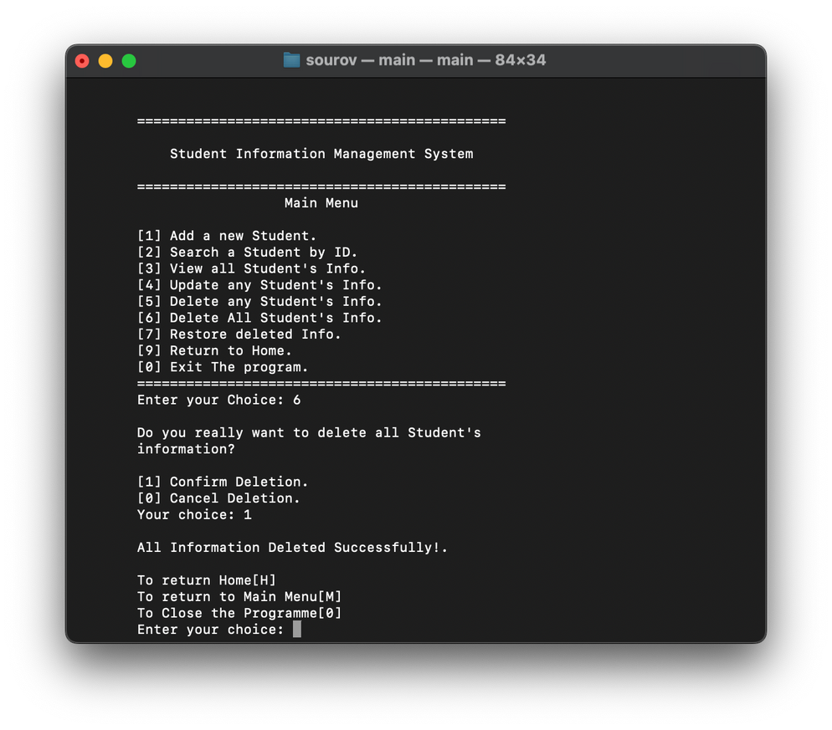

DELETE ALL
First of all we need to have some student information in our database
Then, we can delete it manualy from the Delete all Student's Info option.

Slide 14
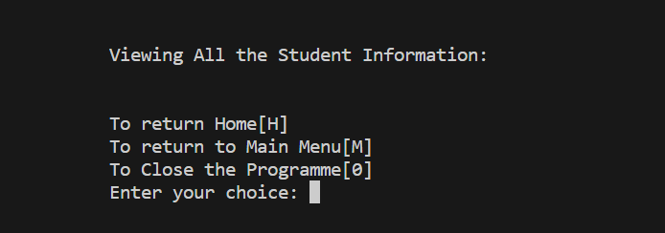
DELETE ALL
Then if we go to check the database we cann’t see any thing here.

Slide 15
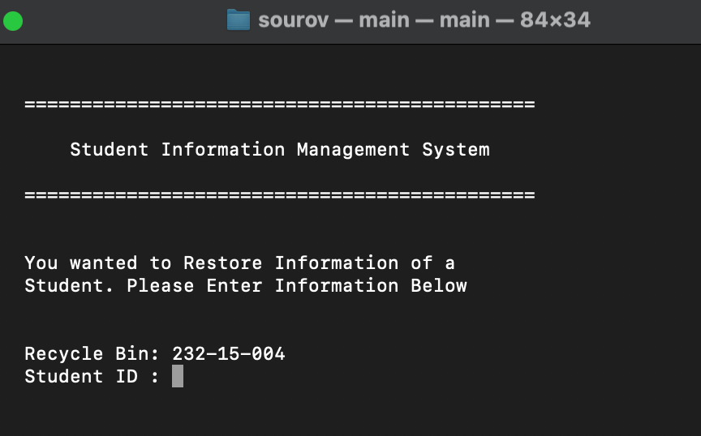
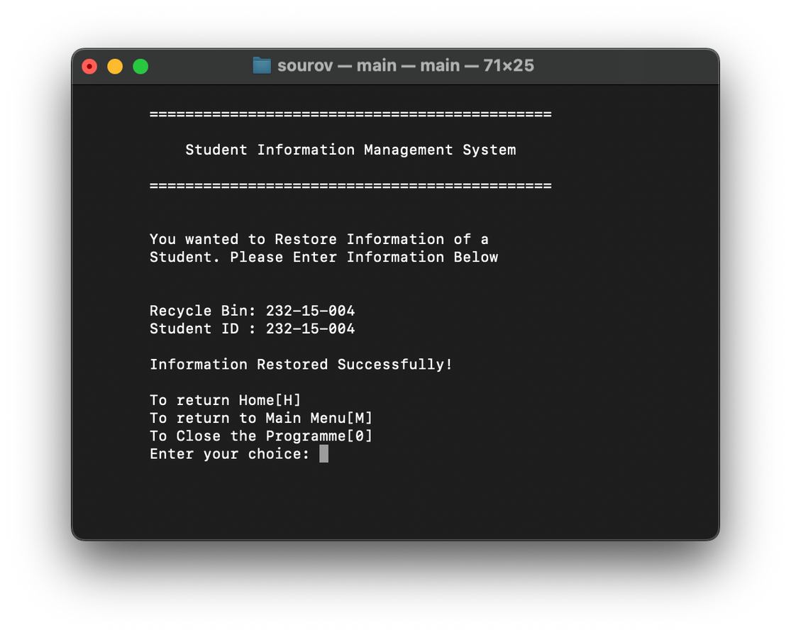
RESTORE
Users can restore the last 10 deleted student’s information one by one from Recycle Bin.

Slide 16
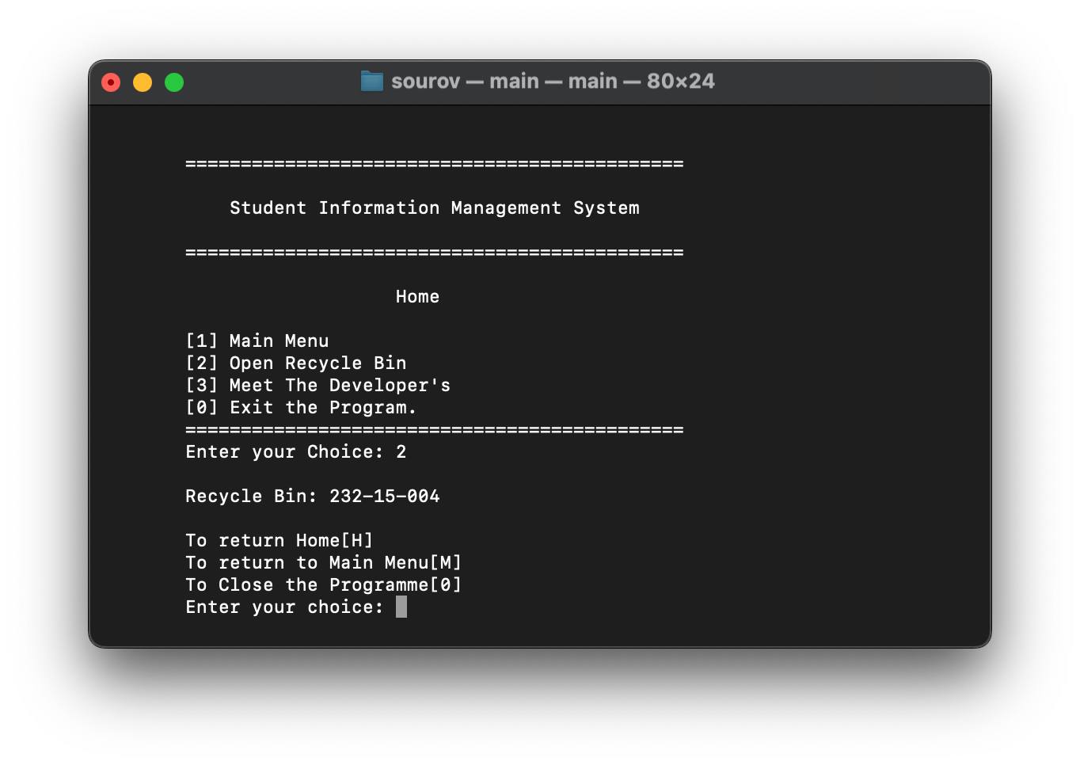

RECYCLE BIN
Recycle Bin store's last 10 deleted students’ information.. Users can restore this information at any time.

Slide 17

Limitations of Our Program
We cannot store more than 10 student’s ID Information in Recycle Bin.
Recyle function shows only student’s ID

Slide 18
THANK YOU!

